Slide 1

Social Media Analytics: Reddit
Unlocking Insights in the Russia-Ukraine War Discourse

Slide 2
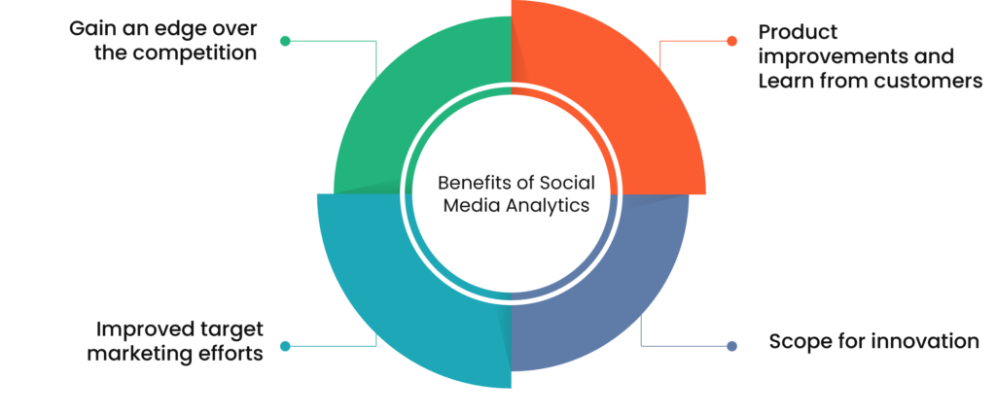
Social Media Analytics
Social media analytics entails gathering, analysing and interpreting data (containing metrics like engagement, reach, sentiments, demographics, etc.) from social platforms.

Slide 3
Reddit
Reddit is a sprawling online platform comprising diverse communities known as subreddits, where users engage in discussions on an extensive range of topics. It serves as a dynamic hub for real-time discourse, offering a unique blend of anonymity, community-driven content curation, and unrestricted expression.
59%
44%
42%
Reddit users are
Americans
Fall within the 18 to 29 age bracket
Reddit users are college graduates
82%
Top 5th
65%
Gen Z users perceive Reddit as a trustworthy platform
Subreddit is World News on Reddit
Reddit users are men

Slide 4
Problem Definition
This project aims to provide a tailored solution that efficiently navigates through the complexity of identifying controversial content on the Russia-Ukraine war while revealing factors influencing the content’s controversiality, enabling users to engage in informed discussions and comprehend the multifaceted perspectives surrounding the conflict.

Slide 5
Project Specifications
Challenges
Target Consumer
Value Proposition
Outcome
Managing information overload, discerning diverse and polarized opinions, efficiently navigating discussions, and addressing the intersectionality of issues
Ranging from the general public seeking insight into Reddit's discussions, to researchers analyzing online discourse, and media professionals aiming to gauge public sentiment
Offers a valuable tool to navigate efficiently, understand diverse perspectives, and facilitate informed discussions within the complex discourse surrounding the Russia-Ukraine war on Reddit.
Provides with the means to identify and comprehend controversial content, enabling deeper understanding of diverse perspectives on the Russia-Ukraine war.

Slide 6
Unique Value Proposition
Transparent Decision-Making
Tailored Analysis
Dynamic Adaptability
Providing users with insights into the factors influencing the controversiality of a post
Model tailored to analyze and predict controversiality within the specific context of the Russia-Ukraine war on Reddit.
Model excels in customization and adaptability, allowing users to modify parameters and features to suit the evolving discourse landscape

Slide 7
Understanding Data
Features
User Interaction Metrics:
Features such as "score," "ups," and "downs" illustrates the engagement levels of comments, indicating the popularity and reception of user contributions within the Reddit community.
Metrics like "user_awardee_karma," "user_awarder_karma," and "user_total_karma" offer a comprehensive view of users' reputation and activity levels, reflecting their overall contribution and influence.
Post Characteristics:
Attributes such as "post_self_text" and "post_title" contain textual content representing the post's content and headline, facilitating content analysis and topic identification.
"post_upvote_ratio" and "post_thumbs_ups" provide indicators of post popularity and user sentiment, offering valuable insights into the reception and engagement levels of posts within the Reddit community.

Slide 8
Understanding Data
Features
Temporal Information:
Timestamps like "created_time" and "post_created_time" enable temporal analysis, allowing researchers to track the timing and frequency of user interactions and post creation.
"user_account_created_time" offers additional temporal context by providing the date when a user's Reddit account was created
Binary Information:
The "controversiality" column serves as the primary target variable, indicating whether a comment is considered controversial (1) or not (0) within the context of discussions about the Russia-Ukraine war on Reddit.
Target

Slide 9
Wireframe
Data Collection
Gather relevant posts and comments related to the Russia-Ukraine war from Reddit discussions
Pre-processing
Clean and tokenize textual data, handle missing values, and remove noise.
Feature Engineering
Extract features such as sentiment scores, word frequency, and user engagement metrics.
Model Development
Train a model to predict controversiality based on the extracted features.

Slide 10
Wireframe
Model Development
Train a model to predict controversiality based on the extracted features.
Evaluation
Assess model performance using accuracy, precision, recall, and F1 score.
Visualization Dashboard
Present insights, highlighting controversial posts and their features.
User Interface
Enables users to interact with the model, explore predictions, and customize for different topics

Slide 11
Thanks!
Do you have any questions?
Please keep this slide for attribution

